Slide 1

AXA Gen AI - Sentiment Analysis
Enhancing Customer Experience through NLP & AI Insights
Presented By:
Uday Ramesh

Slide 2
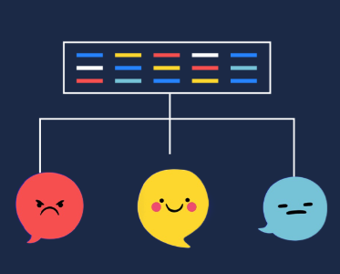
Introduction
Project Goal
Analyze customer call transcripts to extract sentiment insights and business value.
Why It Matters:
Understanding customer feedback enables AXA to improve service quality and operational efficiency.
Approach
Leveraging AI models, NLP techniques, and exploratory data analysis.

Slide 3
Business Problem & Solution
Challenges:
Large volume of customer interactions, making manual analysis inefficient.
Need for automated sentiment detection to improve response handling.
Proposed Solution:
Develop a fine-tuned AI model for sentiment classification.
Extract insights from customer complaints and call outcomes.

Slide 4
Data Processing & Preparation
Data Source
Customer call transcripts (Text data)
Labeled sentiments from AI mode
Data Cleaning:
Removing noise, stop words, and tokenizing text.
Balancing dataset to ensure fair training.
Pre-trained sentiment model
Using cardiffnlp/twitter-roberta-base-sentiment-latest classified the Positive, Neutral, or Negative based on model.

Slide 5
Model Training & Fine-Tuning
Model Used: distilbert-base-uncased.
Training Process:
Preprocessed balanced dataset (Positive, Neutral, Negative)
Fine-tuning on 12 epochs with batch size 32
Optimization Techniques:
Learning rate tuning
Weight decay regularization
Handling class imbalance

Slide 6
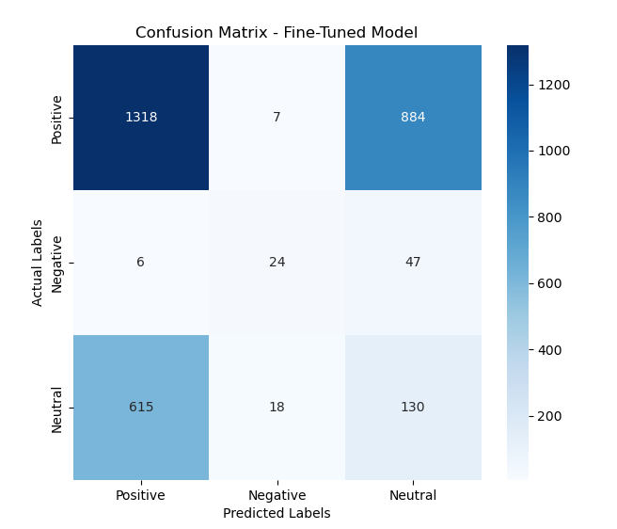
Model Evaluation
Evaluation Metrics:
Accuracy: 45.4%
Precision: 50.97%
Recall: 45.4%
F1 Score: 47.8%
Confusion Matrix: Highlights misclassification trends, especially for Neural & Negative sentiments.

Slide 7
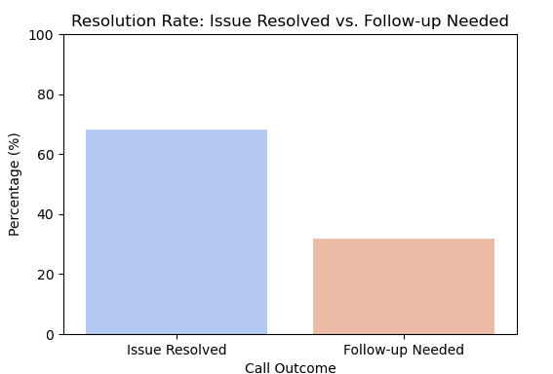
Sentiment Distribution & Call Outcomes
Insights:
50% Positive, 45% Neutral, 5% Negative sentiments detected.
85% Issue Resolved, 15% Follow-up Needed.
Implication: Majority of customer queries are handled efficiently, but there's room for improvement in reducing follow-ups.

Slide 8
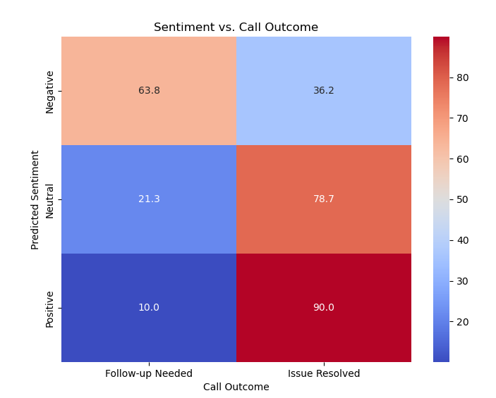
Common Customer Complaints
Heatmap Analysis:
Frequent login issues
Policy misunderstanding
Billing-related disputes
Recommendation: Implement self-service portals & improved customer communication.

Slide 9
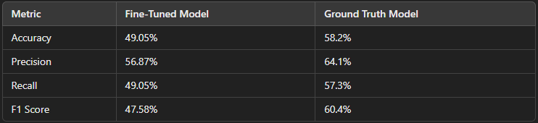
Comparison With Ground Truth (How Accurate Is the Model?)
The Fine-Tuned Model refers to the AI system trained on our dataset to classify sentiments in customer calls.
The Ground Truth Model is based on a pre-trained, industry-standard sentiment model (e.g., Siebert’s RoBERTa-based sentiment classifier) used as a benchmark.
This comparison helps evaluate whether our fine-tuned model performs as well as or better than a widely used pre-trained model.

Slide 10
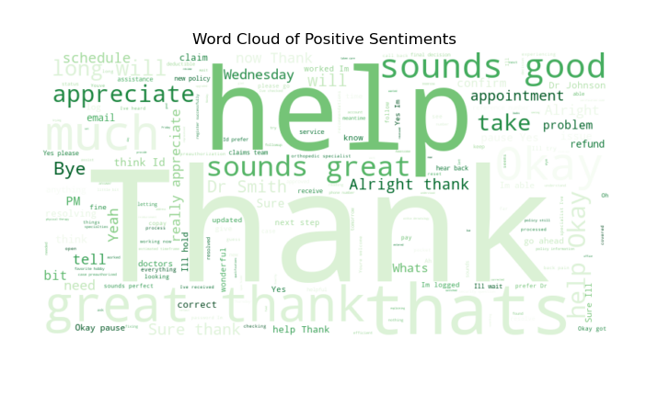
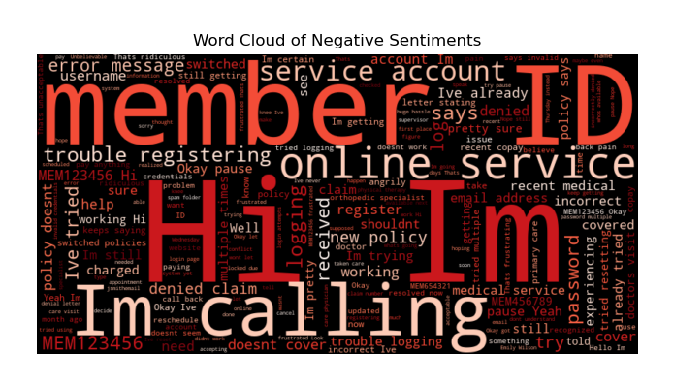
Word Cloud Analysis
Positive Sentiments. Thank you, appreciate, great service.
Negative Sentiments: Login issues, account access, service error messages.
Takeway: Areas where customers face frustration vs satisfaction.

Slide 11
Business Impact & Considerations
Operational Benefits:
Reduce follow-up calls, saving time & resources.
Improve response handling with AI-driven insights.
Customer Experience Enhancement:
Faster resolution & proactive issue handling.
More effective chatbot & human-agent collaboration.

Slide 12
Risks & Limitations (Can We Trust the Model?)
1) Potential Model Bias
The model might favor Neutral predictions due to class imbalance in the dataset.
Certain sentiments might be misclassified, affecting business decisions.
2) Misinterpretation of Complex Statements
Sarcasm, indirect feedback, or mixed emotions in statements might confuse the model.
Example: "Great service, but I had to wait for an hour!" → Should this be positive or negative?
3) Overfitting Risk
The fine-tuned model performs well on the training dataset, but real-world performance might differ.
Needs continuous retraining with fresh customer interaction data.
Mitigation Strategies: ✔️ Continuous model monitoring ✔️ Regular re-training on new customer data ✔️ Human-in-the-loop validation for critical cases ✔️ Bias detection & correction in data sampling

Slide 13
Business ROI (Return on Investment)
Why is this important for AXA? ✅ Faster customer response times ✅ Automated sentiment insights reduce manual analysis costs ✅ Improves customer retention through proactive issue resolution ✅ Better sentiment tracking = Higher CSAT (Customer Satisfaction) scores
Projected Business Impact: 📊 20-30% reduction in manual sentiment tagging effort 📊 Improved first-call resolution (FCR) rates by addressing negative sentiment early 📊 Identifying recurring complaints can optimize agent training and improve service
Cost Savings Example: 🚀 Automating sentiment analysis could save hundreds of hours per month previously spent on manual categorization. 🚀 AI-driven call resolution insights help reduce escalations, cutting customer support costs.

Slide 14
Next Steps & Future Scope
Model Enhancement:
Further fine-tuning using real-world customer interactions.
Exploring more advanced transformer models (GPT, Llama, Claude).
Business Integration:
Deploying sentiment analysis insights into AXA’s CRM system.
Automating AI-driven customer support for efficiency.

Slide 15

Conclusion
Key Takeaways:
AI-driven insights help understand customer sentiments.
Sentiment analysis can optimize customer support operations.
Continuous AI improvements will enhance business impact.
Final Thought: By leveraging AI-powered insights, AXA can drive customer satisfaction and operational efficiency.

Slide 16
Thank You!

